Slide 1
CPE 404
Computer Hardware Design
Dr Osama Hosameldeen
Spring 2021
Lecture 3
Combinational Circuit

Slide 2
Contents
NAND, NOR Universal Gates
  AND-OR to NAND Implementations
XOR Gates, XNOR Gates
  Odd/Even Parity
Electrical Characteristics2
Multiple Level Circuits
Combinational Circuits
Analysis versus Design
Design Hierarchy
CAD Tools
Design Procedure
Notes:
School of Engineering

Slide 3
Universal Gates

Slide 4



NAND Gates
Very common for discrete logic

Slide 5
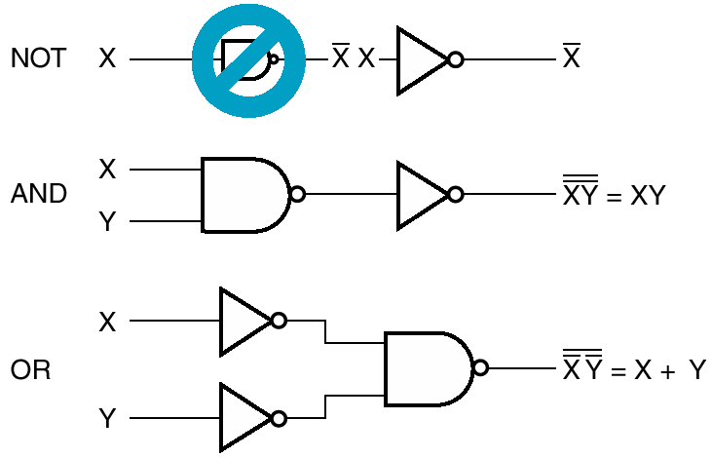
NAND is Universal
Fact: Any digital circuit can be designed and realized using only AND, OR, NOT gates
If we can prove that NAND gate can emulate AND, OR, NOT, then we prove that it is Universal

Slide 6
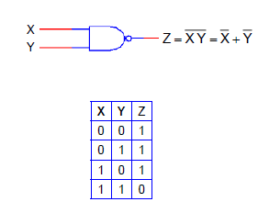
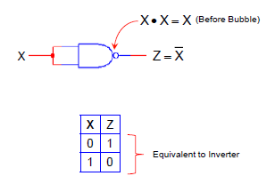
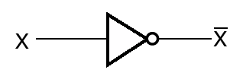
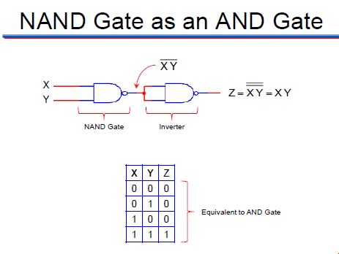
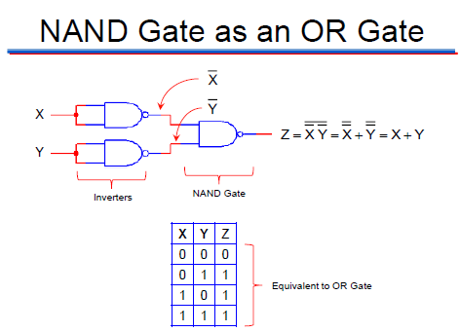
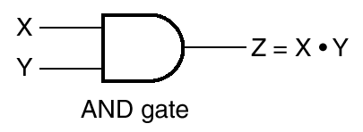
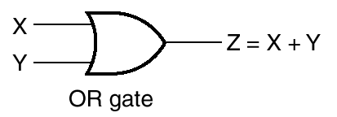
NAND is Universal
DeMorgan’s Theorem: Inverting the inputs of an OR gate produces a NAND gate
Tie two inputs

Slide 7

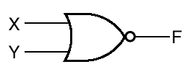
NOR Gates
NOT OR
Also common
X Y Z
0 0
0 1
0
1 1
1
0
0
0

Slide 8
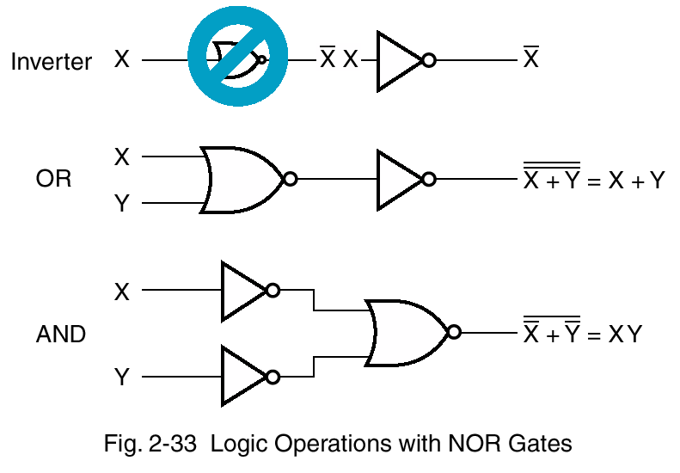
NOR Gate is also Universal
Prove that a NOR gate is Universal by showing it can perform the functionality of (a) NOT gate, (b) OR gate, (c) AND gate
X Y Z
0 0
0 1
0
1 1
1
0
0
0

Slide 9
Conversion to all-NAND

Slide 10
NAND and NOR Implementations
Digital circuits are frequently constructed with only NAND and NOR implementations:
  Both are universal gates
  they are easier to fabricate using (CMOS Technology)
Because of their use, rules have been developed that allow us to convert Boolean functions using AND, OR and NOT into the equivalent NAND and NOR logic diagrams.

Slide 11
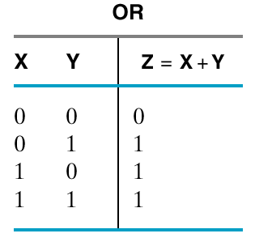
Recall
Inverting the inputs of an OR gate produces a NAND gate
NOT OR
NAND Gate
Identity 17
X.Y = X + Y

Slide 12
Conversion to all-NAND Circuits
The general procedure for converting a multi-level AND-OR diagram into an all-NAND diagram is as follows:
  Convert all AND gates to NAND gates with AND-NOT graphic symbols
  Convert all OR gates to NAND gates with NOT-OR graphic symbols
  Check all the bubbles in the diagram
    Every bubble that is not compensated by another along the same line will require the insertion of an inverter or complement the input literal

Slide 13
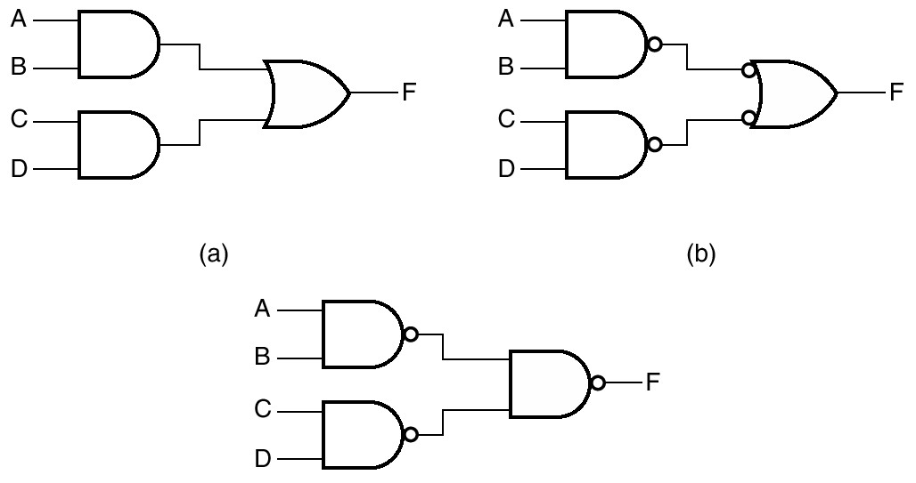
Sum of Products with NAND
  Convert all AND gates to NAND gates with AND-NOT graphic symbols
  Convert all OR gates to NAND gates with NOT-OR graphic symbols
  Check all the bubbles in the diagram
    Every bubble that is not compensated by another along the same line will require the insertion of an inverter or complement the input literal
Easy to think of bubbles as canceling

Slide 14
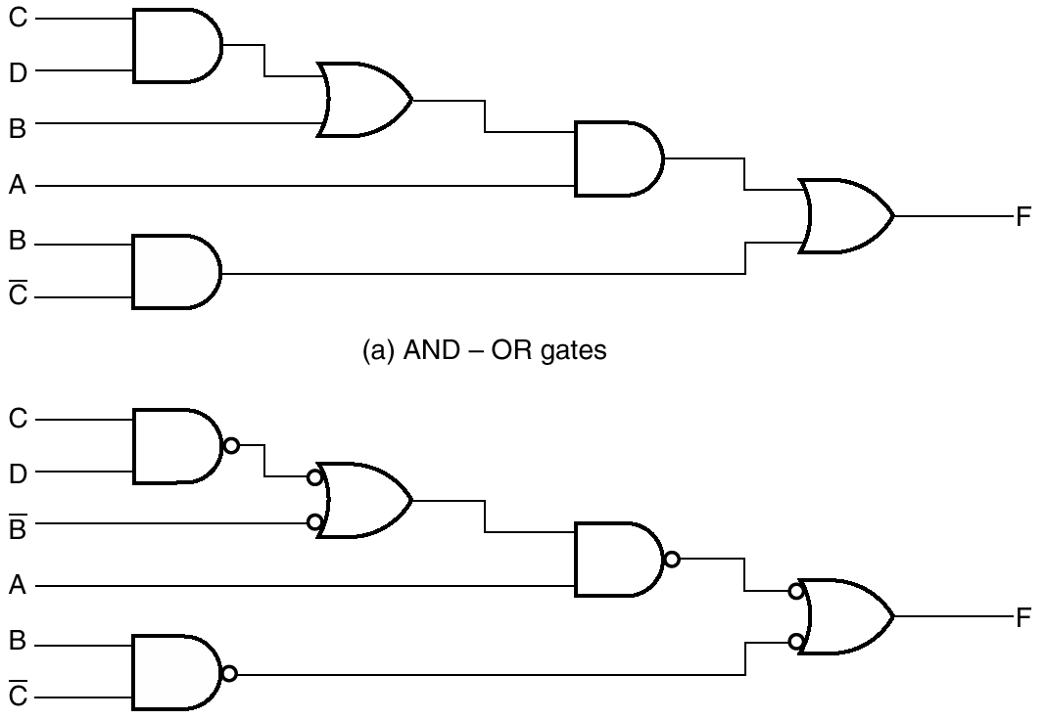
AND-OR Circuit Easy to Convert

Slide 15
Electrical Characteristics

Slide 16
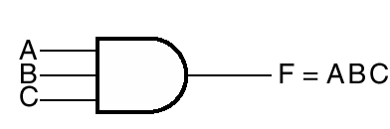
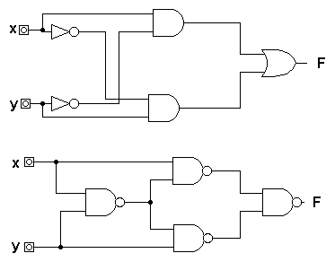
Electrical Characteristics
Fan in – max number of inputs to a gate
Fan out – how many standard loads it can drive (load usually 1)
Noise margin – how much electrical noise it can tolerate
Power dissipation – how much power chip needs
  TTL high
  Some CMOS low (but look at heat sink on a Pentium)

Slide 17
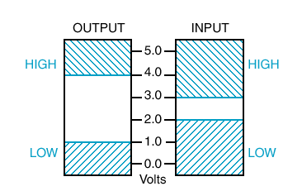
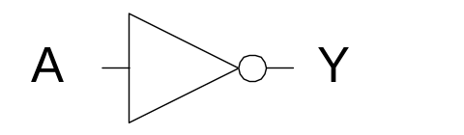
Binary Signaling (Noise Margin)
Zero volts
  FALSE or 0
5 volts
  TRUE or 1
Noise

Slide 18
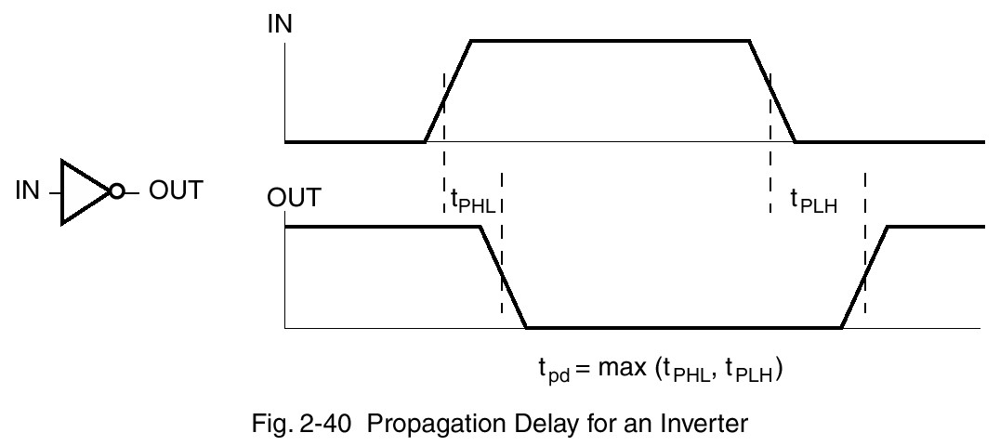
Propagation Delay
Max of high-to-low and low-to-high
Maximum and typical given

Slide 19
Analysis

Slide 20
Combinational Circuits
A combinational logic circuit has:
  A set of m Boolean inputs,
  A set of n Boolean outputs, and
  The output depends only on the current input values
  No Feedback, no cycles
A block diagram:
Combinatorial
Logic
Circuit
m Boolean Inputs
n Boolean Outputs
Notes:
School of Engineering

Slide 21
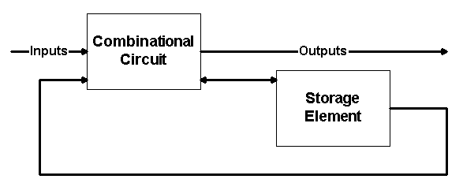
Sequential Circuits
A sequential circuit consists of combinational circuits to which storage elements are connected to form a feedback path.
  Storage elements store binary information.
  Outputs of a sequential circuit are a function of the inputs and the internal state of the storage elements.
Notes:
School of Engineering

Slide 22
Analysis vs. Design
Design of a circuit starts with specification and ends up with a logic diagram.
Analysis for a combinational circuit consists of determining the function that the circuit implements with:
  A set of Boolean functions or
  A truth table, together with a possible explanation of the operation of the circuit.
  We can perform the analysis by manually finding the Boolean equations or truth table.
The first step in the analysis is to make sure that the given circuit is combinational and not sequential (i.e. no feedback or storage elements).
Notes:
School of Engineering

Slide 23
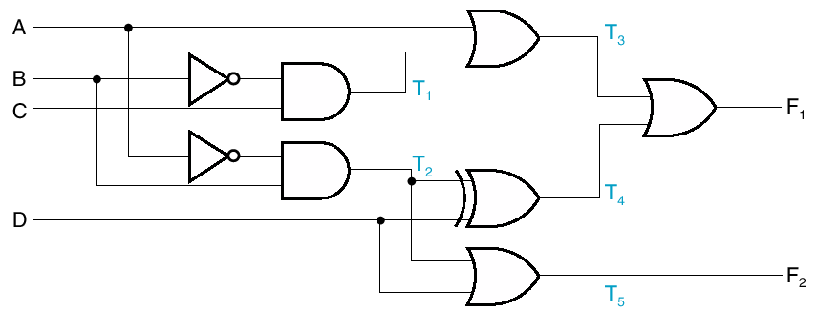
Derivation of Boolean Func.
Or Truth Table
Label gate outputs of input variables
  Determine Boolean functions or values
Label outputs of gates fed by previously labeled gates
  Determine Boolean function or values
Repeat 2 until done

Slide 24


Let’s do this Example

Slide 25
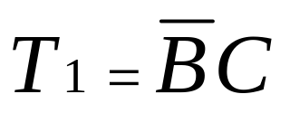
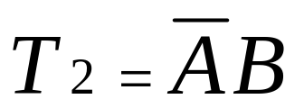
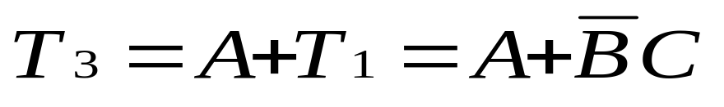
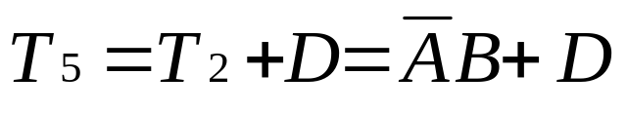
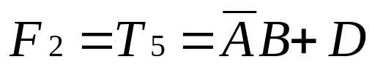
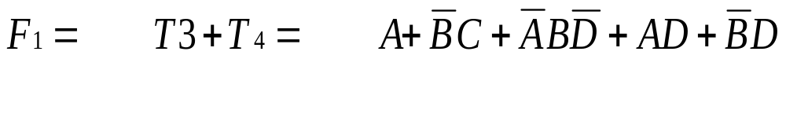
Cont .. Analysis Example

Slide 26
Derivation of Truth Table
Make table with 2^{n} rows, where n is number of inputs
Label some gate outputs
Put those labels and the final outputs on columns of truth table
Work your way across

Slide 27
Derivation of Truth Table
A | B | C | D | T1 | T2 | T3 | T4 | F1 | F2
0 | 0 | 0 | 0 | 0
0 | 0 | 0 | 1 | 0
0 | 0 | 1 | 0 | 1
0 | 0 | 1 | 1 | 1
0 | 1 | 0 | 0 | 0
0 | 1 | 0 | 1 | 0
0 | 1 | 1 | 0 | 0
0 | 1 | 1 | 1 | 0
1 | 0 | 0 | 0 | 0
1 | 0 | 0 | 1 | 0
1 | 0 | 1 | 0 | 1
1 | 0 | 1 | 1 | 1
1 | 1 | 0 | 0 | 0
1 | 1 | 0 | 1 | 0
1 | 1 | 1 | 0 | 0
1 | 1 | 1 | 1 | 0

Slide 28
Design

Slide 29
Design Procedure
Specification
  Write a specification for the circuit if one is not already available
Formulation
  Derive a truth table or initial Boolean equations that define the required relationships between the inputs and outputs, if not in the specification
Optimization
  Use K-Maps to simplify Boolean Expression.
Draw a logic diagram or provide a netlist for the resulting circuit using ANDs, ORs, and inverters
Technology Mapping: Map the logic diagram or netlist to the implementation technology selected (FPGA, PCB)
Verification: Verify the correctness of the final design
HOW TO DEAL WITH A LARGE DESIGN?

Slide 30
Design Hierarchy
Just similar to large software development:
  To design a large chip we need hierarchy
Divide and Conquer
  To create and also to understand
Block is equivalent to object

Slide 31
Example – 4-bit EQUAL circuit
Specifications:
  Input: 2 vectors A(3:0) and B(3:0)
  Output: One bit, E, which is 1 if A and B are bitwise equal, 0 otherwise
Straight forward implementation??
256 entries in the Truth Table!!!
To design another comparator with operands having 5 bits you will
Need to start the design from scratch and have 1024 entries …

Slide 32
Formulation
Since the circuit has eight inputs, use of truth table for formulation is impractical!
  We need to create a truth table with 256 entries!!
In order for A[3:0] and B[3:0] to be equal, the bit values in each of the respective positions, 3 down-to 0, of A and B must be equal.
Use intuition to immediately develop a multiple level circuit. How?

Slide 33
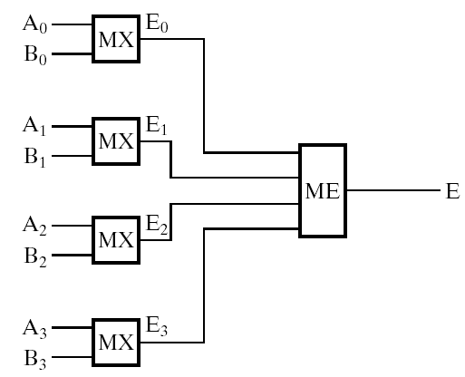
Design: Decomposition
Use Hierarchical Design:
Decompose the problem into:
  Four 1-bit comparison circuits (i.e., One Module/bit)
  An additional circuit that combines the four comparison circuit outputs to obtain E (i.e., Final Module for E)

Slide 34
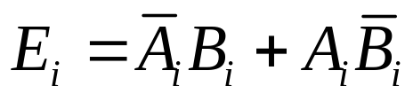
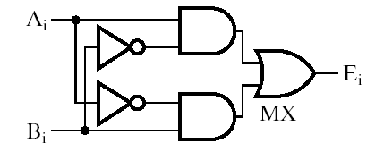
Design for MX module
Define the output of the circuit to be:
  `0’ if both inputs are similar and
  `1’ if they are different?
Ai | Bi | Ei
0 | 0 | 0
0 | 1 | 1
1 | 0 | 1
1 | 1 | 0
Logic function is
Can implement as

Slide 35
4-bit Comparison??
?
E

Slide 36
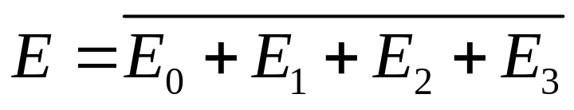
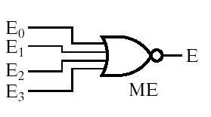
Design of ME module
Final E is 1 only if all intermediate values are 0
So
And a design is
Design for MX module
Ai | Bi | Ei
0 | 0 | 0
0 | 1 | 1
1 | 0 | 1
1 | 1 | 0

Slide 37
Overall Design

Slide 38
Alternative Design for MX module
Define the output of the circuit to be:
  `1’ if both inputs are similar and
  `0’ if they are different?
Ai | Bi | Ei
0 | 0 | 1
0 | 1 | 0
1 | 0 | 0
1 | 1 | 1
Logic function is
E_{i} = A’_{i} B’_{i} + A_{i} B_{i}
Can implement as 2 AND Gates and and OR Gate
How to design the ME Module in this case?

Slide 39
Design Error Check Circuit

Slide 40
XOR Postulates and Theorems
Exclusive NOR (XNOR) can be generated by taking the complement of an XOR operation
  (x ⊕ y)’ = xy + x’y’
The following identities apply to XOR (IMP!)
  x ⊕ 0 = x
  x ⊕ 1 = x’
  x ⊕ x = 0
  x ⊕ x’ = 1
  x ⊕ y’ = x’ ⊕ y = (x ⊕ y)’
XOR is also commutative and associative

Slide 41
XOR = Odd Function
The XOR operation with three or more variables can be converted into an ordinary Boolean function by replacing the ⊕ with its equivalent Boolean expression
  A ⊕ B ⊕ C = (AB’ + A’B)C’ + (AB + A’B’)C
  AB’C’ + A’BC’ + ABC + A’B’C
  ∑(1, 2, 4, 7)
This function is equal to 1 only if one variable is equal to 1 or if all three variables are equal to 1.
  This implies that an odd number of variables must be one. This is defined as an odd function.

Slide 42
Error Detecting Codes
Parity
One bit added to a group of bits to make the total number of ‘1’s (including the parity bit) even or odd
  Odd
  Even
Good for checking single-bit errors
4-bit Example
7-bit Example
1
0 | 1 | 1 | 1
0
1 | 0 | 0 | 0 | 0 | 0 | 1
0
0 | 1 | 1 | 1
1
1 | 0 | 0 | 0 | 0 | 0 | 1

Slide 43
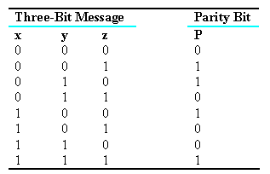
Parity Generation and Checking
XOR functions are very useful in systems requiring error-detection and correction codes.
  A circuit that generates a parity bit is called a parity generator.
  The circuit that checks the parity is called a parity checker.

Slide 44
Parity Generator
Design even parity generator for 3-bit signal
  Perhaps make truth table and K-Map
  Draw with XOR, then sum-of-products w/ NAND gates
How do you design a detector?

Slide 45

Parity Bit Implementation
X
Y
Z
P

Slide 46
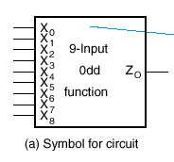
Example
9-input odd function (parity for byte)
Basically checks for even parity!
Block for schematic is box with labels
Without hierarchy how would you start your design?

Slide 47
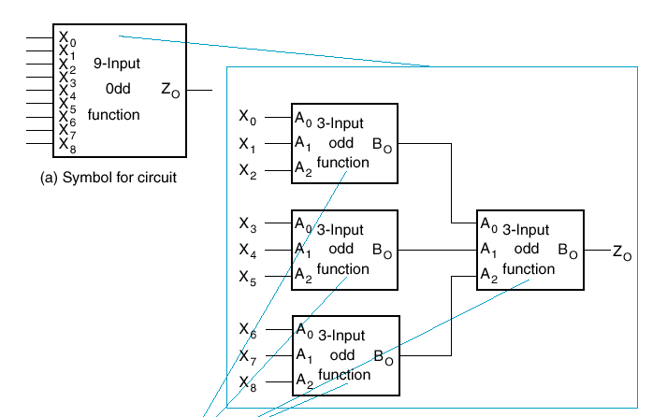
Design Broken Into Modules
Use 3-input odd functions

Slide 48
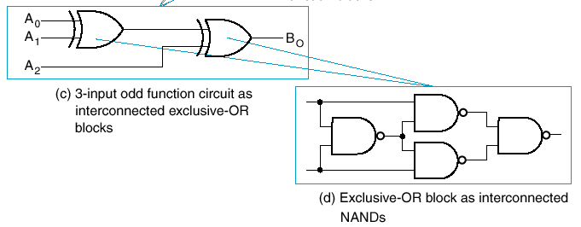
Use NAND to Implement XOR
In case there’s no XOR, for example

Slide 49
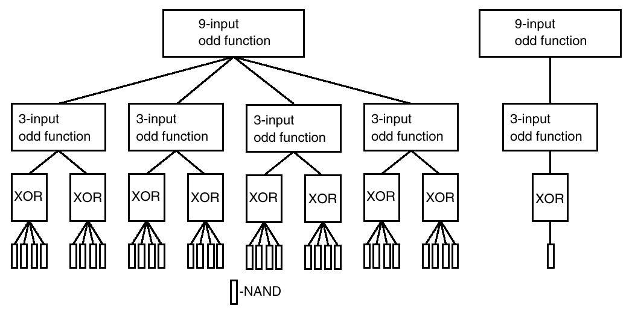
Components in Design
RHS shows what must be designed

Slide 50
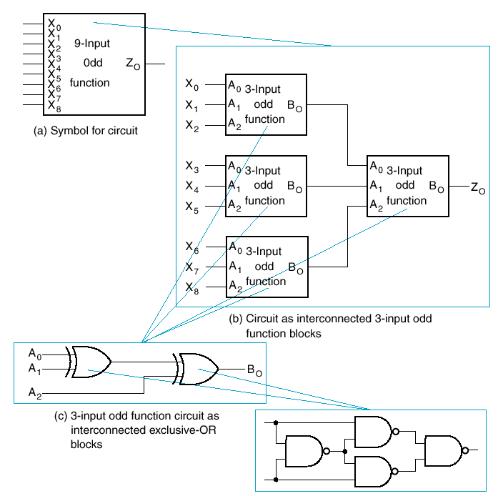
Design Hierarchy

Slide 51
Lecture End

